Slide 1






BATTLE OF SHIPS
Let’s Play!

Slide 2
OUR TEAM
Hayk Aleksanyan
Emilya Arustamyan
Karine Papoyan
Professor: Varduhi Yeghiazaryan

Slide 3
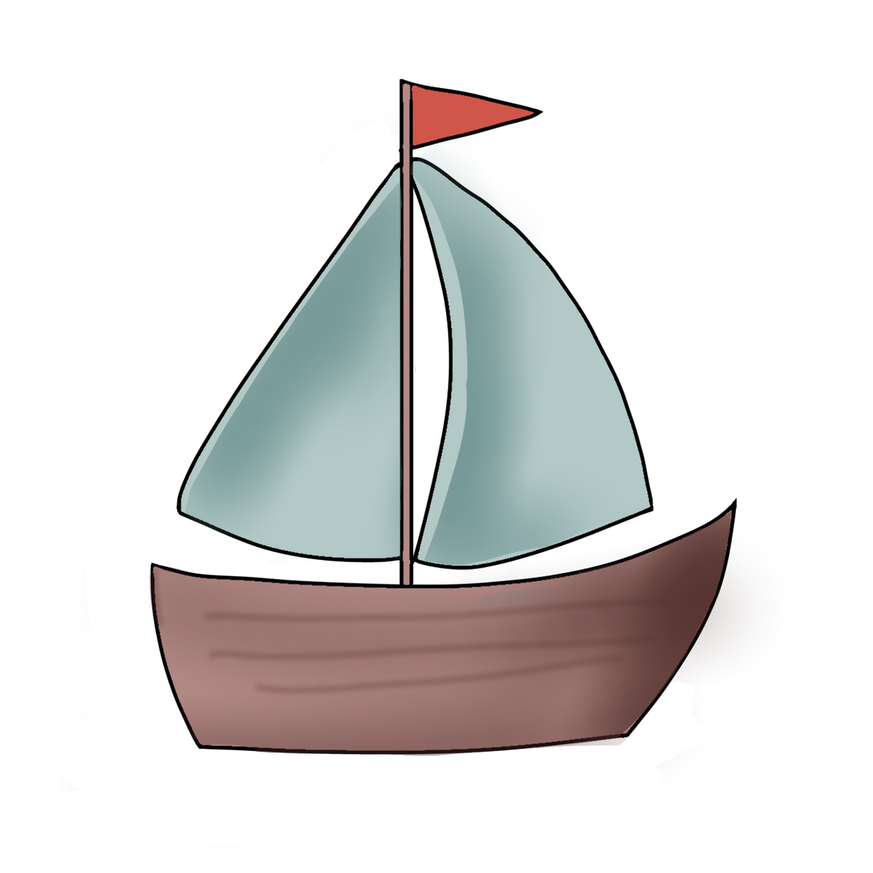
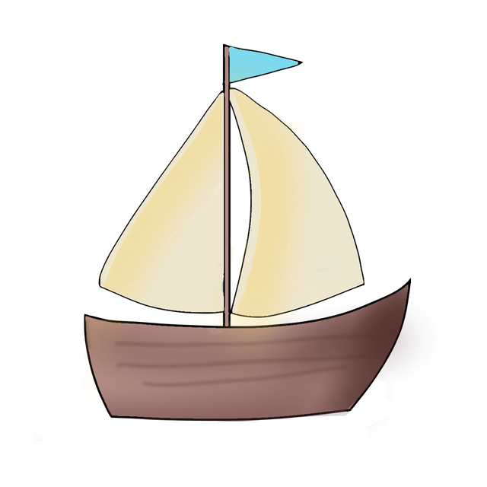
WHAT IS BATTLE OF SHIPS ABOUT?
Battle of Ships is a turn-based strategy game where two players compete to sink each other's fleet.
At the beginning of the game, each player places their 1-unit ships on a grid.
Then, they take turns guessing coordinates, trying to hit and sink the opponent’s ships.
The battle continues until one player successfully destroys all of the enemy ships and wins the game.

Slide 4
OUR CLASSES
Weapon
BasicAttack
Missile
Bomb
WeaponFactory
Main
7. Player
8. PlayerAI
9. Cell
10.Board
11. GameContraller
12. SeaBattleGUI

Slide 5
INTERESTING INHERITANCE
Weapon
Bomb
BasicAttack
Missile

Slide 6
INTERESTING INHERITANCE
Player
PlayerAI

Slide 7
OUR CLASSES
Weapon
BasicAttack
Missile
Bomb
WeaponFactory
Main
7. Player
8. PlayerAI
9. Cell
10.Board
11. GameContraller
12. SeaBattleGUI

Slide 8
OTHER CLASSES
Enum: WeaponType
4 Exception classes
AlreadyAttackedException
IllegalWeaponTypeException
InvalidInputException
InvalidPlacementException

Slide 9
GAME DEMONSTATION

Slide 10


Slide 11

SCAN TO PLAY!

Slide 12
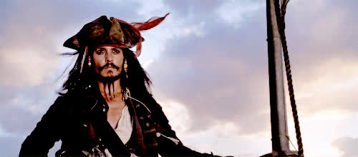
QUESTION
Time

Slide 13
THANK
YOU

